Slide 1
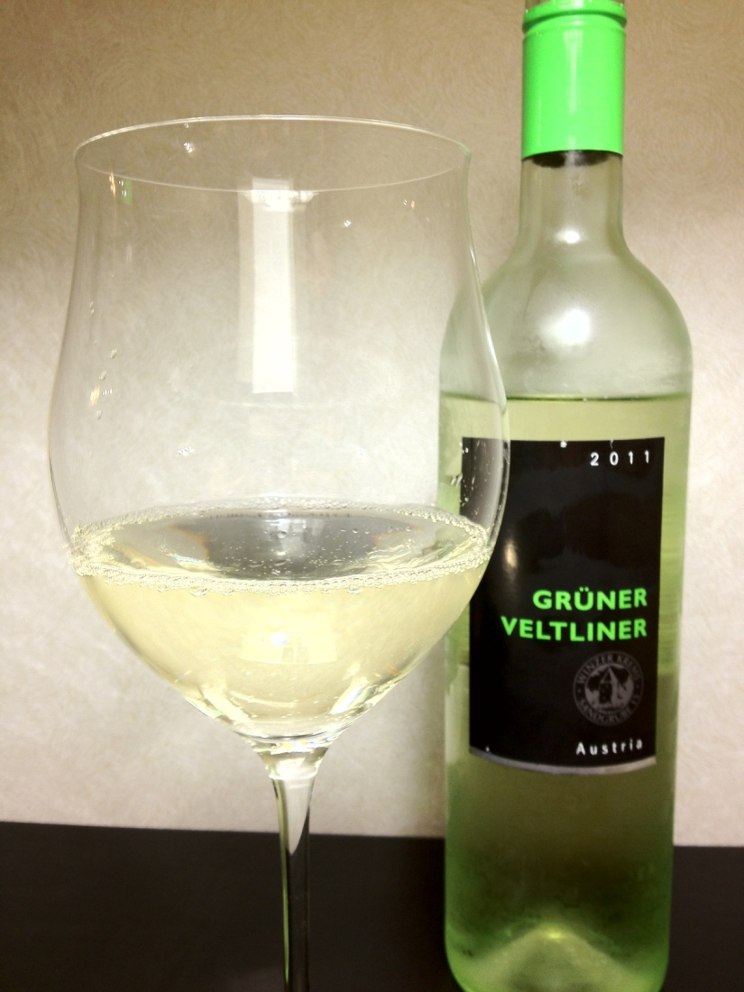
First Pour Wine
2011 Winzer Krems Grüner Veltliner
One of the most planted grapes in Austria, Grüner Veltliner represents a major cultivation in eastern Europe This grape is well know for it’s crisp nature, and food friendly nature. What does 2011 Winzer Krems Grüner Veltliner bring to the table?
Sight: A very pale gold, with a clear edge, and flicks of green
Smell: A plethora of wet rocks, green apples, touches of pear and apple skins.
Sip: A touch of sweetness leads off, quickly replaced with gobs of minerality and lemon pith. Other little notes are overwhelmed by minerals. Very lightly fizzy, highly acidic, light mouth feel.
Savor: A touch of white pepper, bits of lemon pith, and a ton of minerals.
Overall: 2011 Winzer Krems Grüner Veltliner is a very old world style wine. There’s terroir out the wazoo, and it would make a fantastic stand-in for a Sauvignon Blanc. Not an ‘on it’s own’ wine but certainly would be fun with lighter food in the summer, like chicken and spinach sausage.
The Facts…
Price: $9.99
Niederösterreich, Austria
ABV: 12.5
4/23/2012
Notes:
2009 Vin Parfait Chardonnay is another contender for the big chardonnay from California crown. These wines have a tendency to be boldy oaky, or heavy tropical fruit bombs. Many of the most ideal strike a balance, so how does 2009 Vin Parfait Chardonnay stack up?
Sight: A deep gold color, a little bit thick looking
Smell:
Sip:
Savor:
The Facts…
Price: $9.99
Napa, California
ABV: 13.9%

